Slide 1
Assumptions made
The data considered has been taken for the years 2019-2021.
In the headcount sheet, the number of new joiners have been assumed to be taken for (ex-employees +promotions + open roles)
Data cleaning has been done with respect to the above considerations made

Slide 2
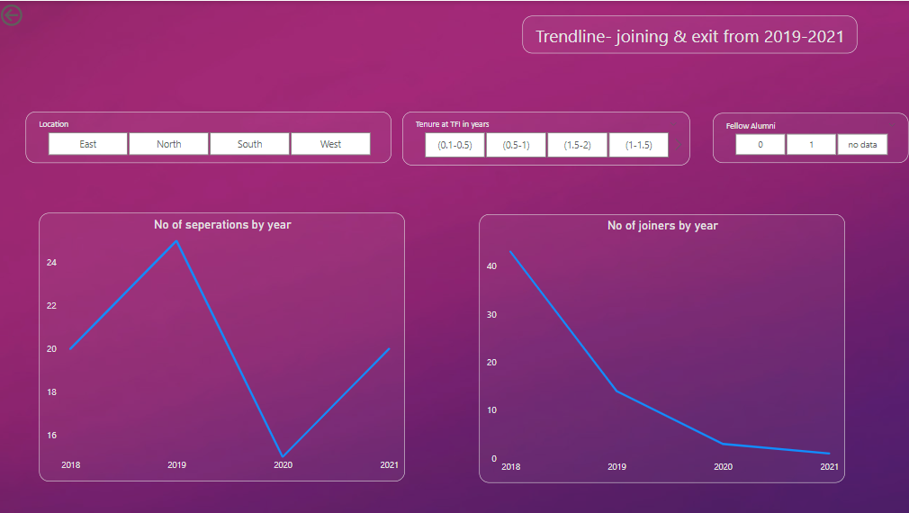
Joining & Exit
The number of people joining since 2018 till 2021 is showing a downward trend
The number of people exiting spikes up in 2019 with the primary reason for leaving being higher education
The separation numbers come down in 2020 by 40% which suggests that people did not find opportunities during the pandemic and also that downsizing was either not done or done to a very small extent
The number of exits for those who are not fellow alumni has increased by 140% from 2020 to 2021.

Slide 3
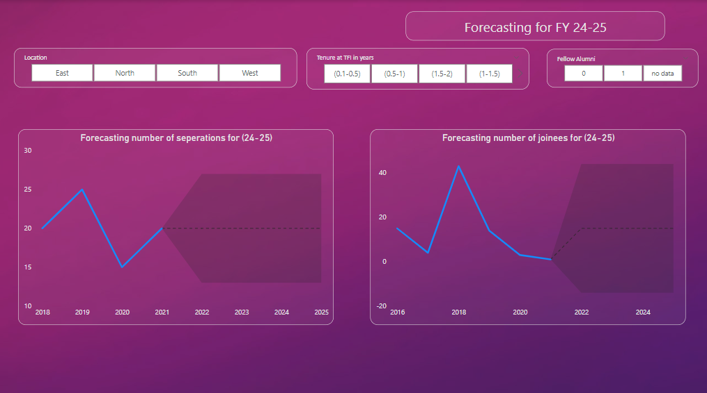
Forecasting
The separation numbers for FY(24-25) stands at 20 with maximum being at 27 and minimum being at 13 as per the data
The joining numbers for FY(24-25) stands at 15 with maximum being at 44 and minimum being at -14 meaning more exit as per the data
The forecasted ratio of joiners to separation is 3:4 across all locations & tenures

Slide 4
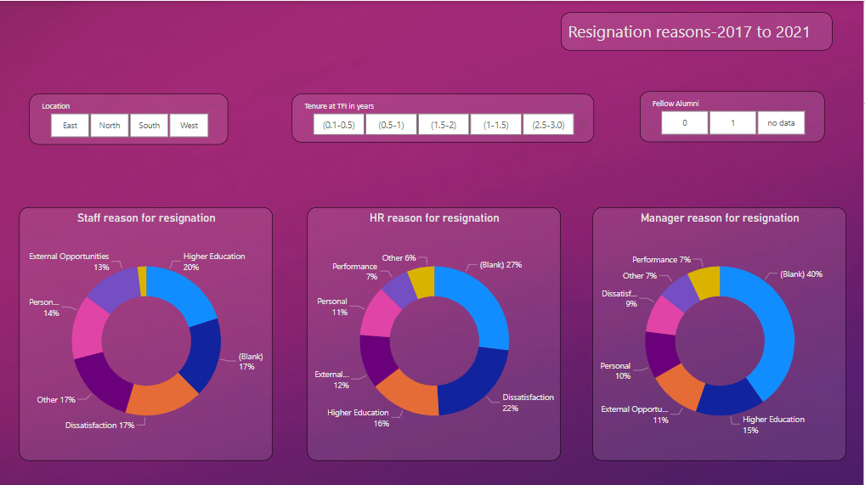
Resignations
People within a tenure of 6 months cite reasons which cannot be clubbed into a single bucket which might suggest a cultural misfit
People within a tenure of 6 months to a year suggest higher education which might suggest the intent of joining as a means to a higher degree
People with a tenure of 2.5 years + cite dissatisfaction as the primary reason for resignation. Analysis with respect to compensation can be done here.

Slide 5
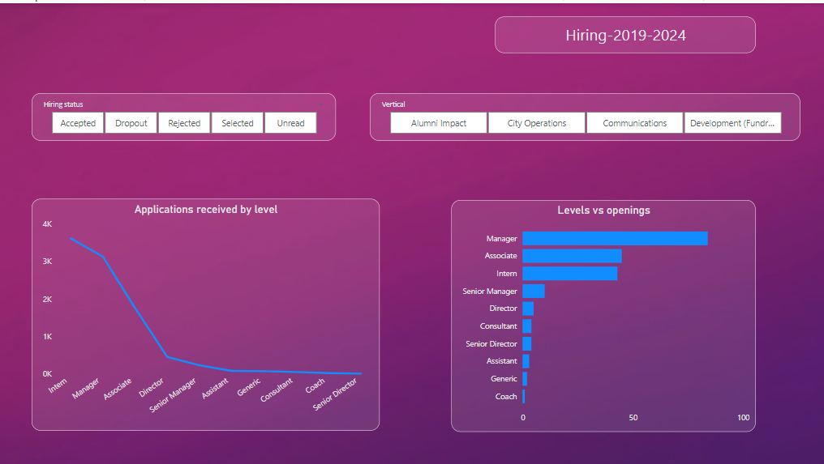
Hiring
The job requisitions vs levels show managerial position openings being high so this might suggest middle management people exiting due to dissatisfaction as seen in the earlier slide.
Number of applications received is high for managers which falls in line with openings
Number of resumes rejected as a percentage of total applications received stands at 58% for the top three open roles. This might call for reflection on the sourcing methods used.

Slide 6
Thank you

